Slide 1


Microprocessor Architectures
Course Code: CET2012A Credits: 2 TH+1 Lab=3

Slide 2
Microprocessor Architecture and Internet of Things
Course Code: CET3014B Credits: 3 Th+2 Lab=5

Slide 3

Course Structure - SY

Slide 4
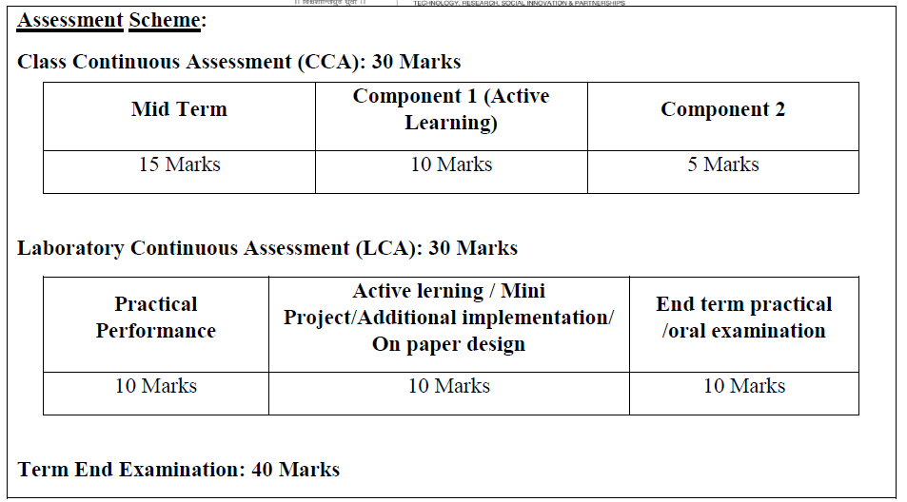
CCA LCA

Slide 5
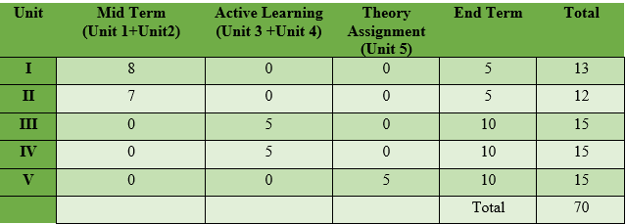
Unit wise distribution of CCA-70 Marks
LCA-30 Marks

Slide 6
Syllabus
Module I: Overview of Embedded System and IoT
Module II:Pentium Architecture:
Embedded Systems: Architecture & Characteristics of ES, Types of Embedded systems, Examples of Embedded Systems. Introduction of IoT: Definition and characteristics of IoT, Technical Building blocks of IoT, Device, Communication Technologies, Data, Physical design of IoT, IoT enabling technologies, IoT Issues and Challenges- Planning, Costs and Quality, Security and Privacy, Risks. Example: Smart Home /Smart Agricultural.
Pentium features, Pentium superscalar architecture - Pipelining, Branch prediction, and Instruction and Data caches. The Floating-Point Unit: features, pipeline stages & data types. Pentium programmer's model, register set, System registers, addressing modes and Instruction set.

Slide 7
Syllabus
Module III:Pentium operating modes:
Pentium Modes of Operation, Pentium Real address mode: Memory organization, Memory segments, segment registers, logical to physical address generation
Protected mode: Segmentation unit support registers, related instructions, segment Memory descriptors, logical to linear address translations.
Module IV:Paging and Protection:
Paging Unit: support registers, related data structures, linear to physical address translation, TLB Protection by segmentation, privilege-levels, rules of inter-privilege level transfer for data and code segments, page level protection.

Slide 8
Syllabus
Unit 5: Pentium Task Management and Interrupt handling:
Task Management, support registers, related data structures, Task switching. Interrupt and Exception Overview, Sources of Interrupts & exceptions, Exception and Interrupt Vectors, Interrupt Descriptor Table (IDT), IDT Descriptors, Exception- or Interrupt-Handler Procedures

Slide 9
Learning Resources:
Text Books:
1. The Internet of Things by Hakima Chaouchi Publishers: ISTE and Willey
2. James Antonakos, “The Pentium Microprocessor”, 2004, Pearson Education ISBN – 81-7808-545-3.
Reference Books:
1. Beginning Arduino by Micheal McRoberts Publishers: Technology in Action
2. IoT Fundamental by Devid Hanes Publishers: CISCO
3. Raspberry Pi Cookbook for Python Programmers by Tim Cox Publishers: PACKT
4. The Official Raspberry Pi Project Book
5. Beginning Sensor Networks with Arduino and Raspberry Pi by Charles Bell Publishers: Technology in Action
6. Intel architecture software developer's manual volume 3.
7. Intel architecture software developer's manual volume 1.
8. Intel 64 and IA-32 Architecture’s software developer's manual

Slide 10
Course Objectives:
By participating in and understanding all facets of this Course a student will be able:
1. Knowledge:
i. To understand the components and techniques used in IoT development environment
ii. To apply the knowledge of fundamentals in IoT for various applications.
iii. To acquire the knowledge of the Pentium processor architectural features, programmer’s model, system registers.
2. Skill:
i. To learn Pentium addressing modes and instruction set for the development of x86/64-bit assembly language programs.
3. Attitude:
i. To describe the role of Memory Management Unit and Privilege levels in protected mode of Pentium processor.
ii. To learn the role of CPU in handling multitasking and processing of interrupts and exceptions in Pentium environment.

Slide 11
Course Outcomes:
By the end of the course, students will be able to
1. Describe the details of IoT based systems.
2. Demonstrate the use of common IoT platforms and installations.
3. Discuss Pentium architecture and programmer’s model.
4. Apply the Assembly Language Programming skills of Pentium processor.
5. Interpret the demand paging and protection mechanism supported in Pentium Architecture.
6. Demonstrate the concept of Task management and Interrupt handling within the Pentium processor.

Slide 12
Unit 4: Paging and Protection
Paging Unit: support registers,
related data structures,
linear to physical address translation,
TLB Protection by segmentation,
privilege-levels, rules of inter-privilege level transfer for data and code segments,
page level protection.

Slide 13
Protection
Each reference to memory is checked by the hardware to verify that it satisfies the protection criteria.
All these checks are made before the memory cycle is started.
Any violation prevents that cycle from starting and results in an exception.
Invalid attempts to access memory result in an exception.

Slide 14

Field and Flag in Protection system
Different fields and flags are used in segment level protection mechanism:---
Descriptor type (S) flag: Bit no 12 (in the second double word of seg. descriptor ), defines is it a system segment or Code/Data segment.
Type Field: Bit 8-11, determines type of code/data or system segment ( Read/write)
E flag : Bit 10
Limit Filed: Bit 0-19, determine size of segment along with G and E flag.
G flag: Bit 23
Descriptor Privilege level (DPL): bit 13-14, determines the privilege level of the segment described by the segment descriptor
Requested Privilege level (RPL): bit 0-1, of any segment selector, Specifies the RPL of segment selector.
Current Privilege Level(CPL): bit 0-1 of CS segment register, indicates the privilege level of currently executing program or procedure.

Slide 15
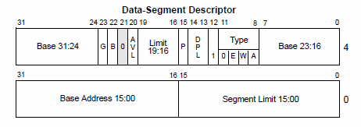
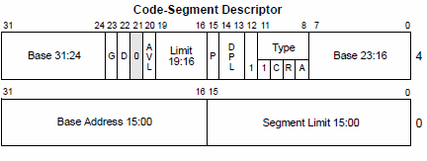
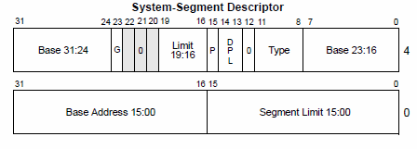
Field and Flag in Protection system

Slide 16
Data Segment Descriptor
Base Addr. 31:24 | G | B | 0 | AVL | Seg. Limit 19:16 | P | DPL | S ‘1’ | 0 | E | W | A | Base Addr 23:16 | Base Addr 15:00 | Segment Limit 15:00
TYPE
Code Segment Descriptor
Base Addr. 31:24 | G | D | 0 | AVL | Seg. Limit 19:16 | P | DPL | S ‘1’ | 1 | C | R | A | Base Addr 23:16 | Base Addr 15:00 | Segment Limit 15:00
TYPE
System Segment Descriptor
Base Addr. 31:24 | G |  | 0 |  | Seg. Limit 19:16 | P | DPL | S ‘0’ | TYPE | Base Addr 23:16 | Base Addr 15:00 | Segment Limit 15:00

Slide 17
Segment Level Protection
All five aspects of protection apply to segment translation:
1. Type checking.
2. Limit checking.
3. Restriction of addressable domain.
4. Restriction of procedure entry points.
5. Restriction of instruction set.
The segment is the unit of protection, and segment descriptors store protection parameters.
Protection checks are performed automatically by the CPU when the selector of a segment descriptor is loaded into a segment register and with every segment access.
Segment registers hold the protection parameters of the currently addressable segments.
The protection parameters are placed in the descriptor by systems software at the time a descriptor is created.
Any violation of these protection checks results in an exception.

Slide 18
Type Checking
Segment descriptors contain type information in two places:
The S (descriptor type) flag.
The type field: Used to determine whether the current memory access (Read/Write/Execute) is allowed.
Some examples of typical operations where type checking is performed-
The CS register only can be loaded with a selector for a code segment.
The LDTR can only be loaded with a selector for an LDT.
No instruction may write into an executable segment/read only data segment.
No instruction may read from an executable only segment.
The LLDT instruction must reference a segment descriptor for an LDT.

Slide 19
Limit Checking
The limit field of a segment descriptor is used by the processor to prevent programs from addressing outside the segment.
The processor's interpretation of the limit depends on the setting of the G (granularity) bit.
When G=0, the actual limit is the value of the 20-bit limit field as it appears in the descriptor. (Number of bytes)
When G=1, the actual limit may range from 0FFFH (2¹²-1 or 4 kilobytes) to 0FFFFFFFFH(2³²-1 or 4 gigabytes). (Number of 4 Kilobytes)
Limit checking catches programming errors such as runaway subscripts and invalid pointer calculations.
In addition to checking segment limits, the processor also checks descriptor table limits.
Null Segment Selector Checking.

Slide 20
Privilege
Pentium checks that the application is privileged enough to:
Execute certain instructions.
Reference data other than its own.
Transfer control to code other than its own.

Slide 21
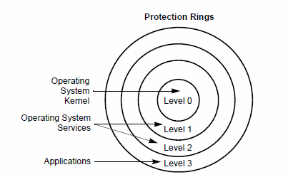
Privilege Levels
Privilege level – the authority of the program with which it can access / use resources of the system.
Processor segment protection Mechanism recognizes 4 privilege levels form 0 to 3 with 0 as high and 3 as low privilege.

Slide 22
Privilege Levels
Level 0- Level zero is the highest privilege level. Typically, only the OS kernel will run with privilege level zero. This permits it to perform any operation.
Level 1 - Level one is the next privilege level. It is typically assigned to high-priority device drivers and OS services. It could also be assigned to debuggers to protect them from alteration by low-priority device drivers and applications programs.
Level 2 - Level two is typically assigned to lower-priority device drivers.
Level 3 - Level three is the lowest priority and is typically assigned to applications programs.

Slide 23
Privilege Levels
The center is reserved for most privilege code/data and stacks, used in critical software, usually kernel of operating system.
Outer rings are less critical section / less privileged
Processor limits the access from low privilege program or task to access high privilege program, except under controlled situation.
When processor detects privilege level violation is generates General-Protection exception (#GP)

Slide 24
Terminology
PL: Privilege Level.
RPL: Requested Privilege Level.
DPL: Descriptor Privilege Level.
CPL: Current Privilege Level.
Task:
One instance of the execution of a program.
Tasks are also referred to as processes.

Slide 25
DPL, CPL, RPL
Privilege level – the authority of the program with which it can access / use resources of the system.
DPL – Descriptor’s privilege level
Privilege level of the segment described by the segment descriptor
CPL – Current Privilege level
It is the privilege level of the program presently in execution
RPL – Requestor’s privilege level
It is the privilege level as defined in the selector

Slide 26
Privilege Checking
Prog. A cannot access Prog. X since no call gate available for A to access program at PL0
Prog. C can access Prog. X since call gate available for C to access program at PL0
A
B
Prog. B can access Prog. X since call gate available for B to access program at PL0
C
PL3
PL2
PL1
PL0
Gate for X
X
An application program running at PL = 3 may call an operating system routine at PL = 1 or 0 (via a gate) which would cause the task's CPL to be set to 1 until the operating system routine was finished.
Gate for X

Slide 27


CPL- Current Privilege Level
It is the level of currently executing program or task.
It is stored in bit 0 and 1 of segment registers CS and SS.
CPL is equal to the privilege level of Code Segment from which instruction is executed.
Processor changes the CPL when program control is transferred to Code Segment with Different privilege level.
A task's CPL may only be changed by control transfers through gate descriptors to a code segment with a different privilege level.
An application program running at PL = 3 may call an operating system routine at PL = 1 (via a gate) which would cause the task's CPL to be set to 1 until the operating system routine was finished.

Slide 28
Requested Privilege Level (RPL)
The privilege level of the original supplier of the selector.
RPL is determined by the least two significant bits of a selector of data or code segment to be accessed.
The processor checks the RPL along with the CPL to determine if access to a segment is allowed.
If the RPL > CPL, then the RPL overrides the CPL and vice versa.
RPL is used to insure that privileged code does not access a segment on behalf of Application program, unless the program itself has access privilege to that segment.

Slide 29
Requested Privilege Level (RPL)
RPL of a segment selector for a data segment is under software control.
For example, an application program running at a CPL = 3 can set the RPL for a data segment selector to 0. With the RPL set to 0, only the CPL checks, not the RPL checks, will provide protection against deliberate, direct attempts to violate privilege-level security for the data segment.
To prevent these types of privilege-level-check violations, a program or procedure can check access privileges whenever it receives a data-segment selector from another procedure. (ARPL-access privilege).

Slide 30
Privilege Check
Code Segment ------(Accessing)----→ Data Segment
Code Segment ----(Accessing)---→ Conforming Code Segment [C=1]
CPL >= DPL
Code Segment ------(Accessing)----→ Non Conforming Code Segment
DPL = CPL
Achieved by checking conditions based on
RPL, DPL and CPL
Code Accessing Data
DPL >= Max(CPL, RPL)

Slide 31
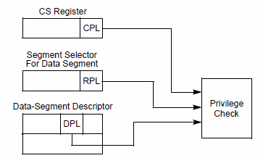
Privilege Level check for DS: Code Segment ------(Accessing)----→ Data Segment
Code Accessing Data
DPL >= Max(CPL, RPL)
2
DPL =3
CPL =2
RPL = 1
1
3
To access operand in Data Segment, the segment selector must be loaded into the data segment register (DS,ES,FS or GS) or SS

Slide 32
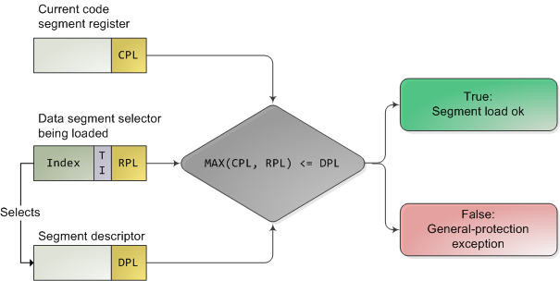
Privilege Level check for DS
Code Accessing Data
DPL >= Max(CPL, RPL)

Slide 33
Privilege Level check for DS
To access operand from Data Segment, the segment selector must be loaded into the data segment register (DS,ES,FS or GS) or SS
Processor performs privilege check (CPL,RPL,DPL)
Processor loads segment selector into segment register if the DPL is numerically greater than or equal to both the CPL and RPL, otherwise General Protection fault is generated and segment register is not loaded
DPL >= Max(CPL and RPL)
3>=max(2 and 1)
2
1
3

Slide 34
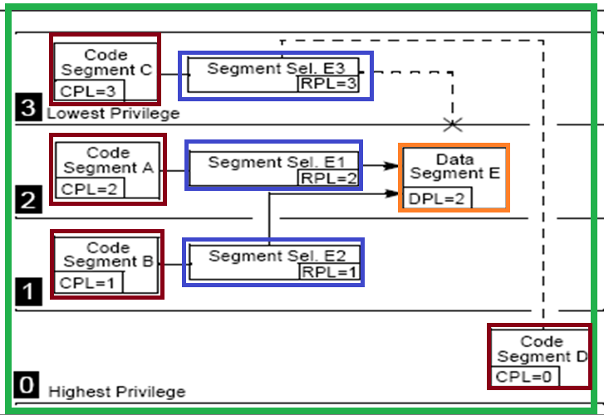
Privilege Level Checking When Accessing Data Segments
Question: Can Code Segment A able to access DS E using E1 selector?
Quiz: Answer is in Able or Unable
Q1. CS – A ------to access DS E using E1 selector
Q1. Ans: CS – A able to access DS E using E1 selector
Q2. CS- B ----- to access DS E using E2 selector
Q2. Ans: CS- B able to access DS E using E2 selector
Q3. CS C is ------ to access DS E using E3 selector
Q3. Ans: CS C is unable to access DS E using E3 selector
Q4. CS D is ------ to access DS E using E3 selector
Q4.Ans: CS D is unable to access DS E using E3 selector
DPL >= Max(CPL and RPL)

Slide 35
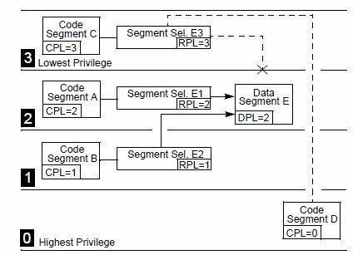
Data Segment : Privilege Access (Answer)
CS – A able to access DS E using E1 selector as,
CPL of A and RPL of E1 = DPL E
CS- B able to access DS E using selector E2 as,
CPL of B and RPL of E2 < DPL of E
DPL >= Max(CPL, RPL)

Slide 36
Data Segment : Privilege Access (Answer)
CS C is unable to access DS E using selector E3 as,
CPL of CS C and RPL of E3 > DPL of DS E
CS D is unable to access DS E using selector E3 as
CPL of CS D < DPL of DS E
DPL >= Max(CPL, RPL)

Slide 37
Privilege Level check : Data Segment
When CPL 0:
Data Segment at all PL are accessible
When CPL 1:
DS at PL 1 through 3 are accessible
When CPL 2:
DS at PL 2 to 3 are accessible
When CPL 3:
DS at PL 3 is only accessible
If max (CPL,RPL) <= DPL, Access allowed.
Assume CPL=RPL
CPL | Data segments accessed (DPL)
0 | 0,1,2,3
1 | 1,2,3
2 | 2,3
3 | 3
RPL of segment selector can always override the addressable domain of program

Slide 38
Accessing Data in Code Segments
In some instances it may be desirable to access data structures that are contained in a code segment.
Method 1: Load a data-segment register with a segment selector for a nonconforming, readable code segment.
Method 2: Load a data-segment register with a segment selector for a conforming, readable, code segment.
Method 3: Use a code-segment override prefix (CS) to read a readable, code segment whose selector is already loaded in the CS register.
E.g. MOV BL,CS:[ESI]
Method 1: The same rules for accessing data segments apply to method 1.
Method 2 is always valid because the privilege level of a conforming code segment is effectively the same as the CPL, regardless of its DPL.
Method 3 is always valid because the DPL of the code segment selected by the CS register is the same as the CPL.
DPL >= Max(CPL, RPL)

Slide 39
Privilege Level Checking When Transferring Program Control Between Code Segments
Program control transfers are carried out with the-----------------
JMP
CALL
RET
INT n
IRET instructions (The IRET instruction is used at the end of an interrupt service procedure to return execution to the interrupted program. )
The Exception and Interrupt mechanisms.
The NEAR forms of the JMP, CALL, and RET instructions transfer program control within the current code segment, so privilege-level checks are not performed.

Slide 40
Privilege Level Checking When Accessing Other Code Segments
Code segments can be either conforming or nonconforming.
A transfer of execution from code (e.g. CPL=3) into a more privileged conforming segment(e.g. CPL=1) allows execution to continue at the current privilege level (i.e. CPL=3).
A transfer of execution from code segment into a nonconforming segment at a different privilege level results in a general-protection exception (#GP), unless a call gate or task gate is used
Non confirming code segment
RPL is replaced by DPL after successful access
The same field indicates CPL
DPL = CPL
Confirming Code Segment
RPL field status is retained
The CPL >= DPL

Slide 41
Privilege Level Checking When Transferring Program Control Between Code Segments
A JMP or CALL instruction can reference another code segment in any of four ways:
The target operand contains the segment selector for the target code segment.
The target operand points to a call-gate descriptor, which contains the segment selector for the target code segment.
The target operand points to a TSS, which contains the segment selector for the target code segment.
The target operand points to a task gate, which points to a TSS, which in turn contains the segment selector for the target code segment.

Slide 42
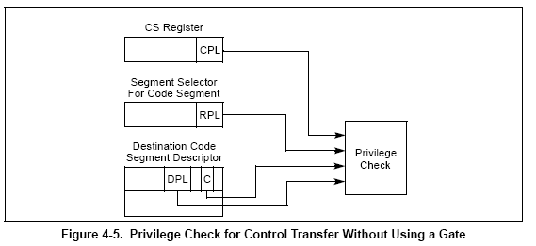
Code accessing Code (Non confirming code segments)
Code Segment ---(Accessing)--→ Non Conforming Code Segment [C=0]
Direct Calls or Jumps to Code Segments
Rule
DPL = CPL

Slide 43
Code accessing Code (Non confirming code segments)
Running Code
Rule
DPL = CPL
Code Segment Register
RPL = 3
Code Segment A
CPL = 3
X
Code Segment
CPL = 2
Code Segment Register
RPL = 2
Code Segment B
DPL = 2
X
One code segment can access another non conforming code segment with different privilege level only using a special descriptor called “Call Gate” which is discussed later in the unit.
Code Segment
CPL = 1
Data Segment Register
RPL = 1

Slide 44
Code accessing Code (Conforming Code Segments)
Code Segment ------(Accessing)----→ Conforming Code Segment [C=1]
Can be called by a code with CPL >= DPL of destination code segment
Conforms to the privilege level of the caller code
E.g. If PL 3 code transfers control to a conforming code segment then conforming code runs at CPL=3.
CPL does not change
Allow sharing by codes with different privilege levels
Application – math libraries

Slide 45
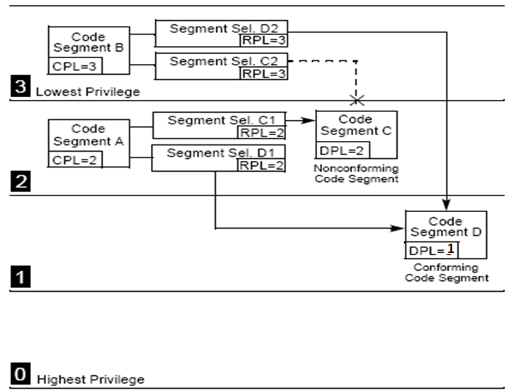
Example: Code accessing Code Confirming Code Segment
Code segment D is a conforming code segment.
Therefore, calling procedures in both code segment A and B can access code segment D (using either segment selector D1 or D2, respectively), because they both have CPLs that are greater than or equal to the DPL of the conforming code segment.
For conforming code segments, the DPL represents the numerically lowest privilege level that a calling procedure may be at to successfully make a call to the code segment.
CPL >= DPL

Slide 46
Code accessing Code (Conforming Code Segments:) Summary
Can be defined with different privilege levels.
Do not impart additional privileges.
Do not remove existing privileges.
Do not alter RPL bits in the Code segment register.
Can be shared by code at all privilege levels.
Application – math libraries, exception handlers
Can be called by a code with CPL >= DPL of destination code segment.
the processor generates a general-protection exception (#GP) only if (CPL <= DPL) the CPL is less than the DPL.
The segment selector RPL for the destination code segment is not checked if the segment is a conforming code segment.

Slide 47
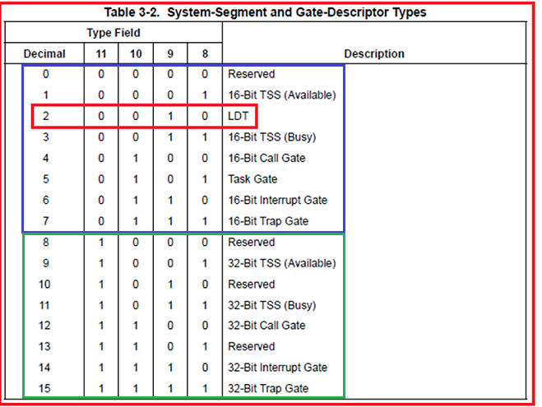
System Descriptor Types if S=0

Slide 48
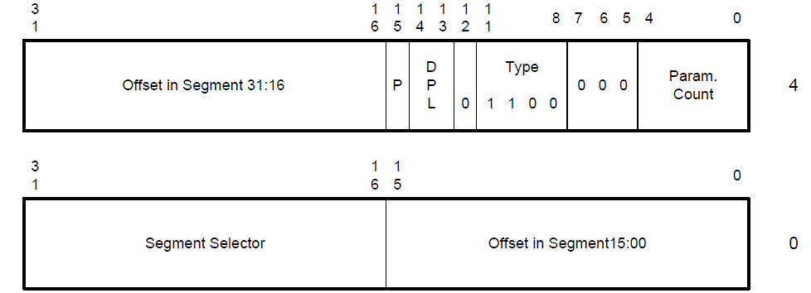
Call Gate Descriptor
System descriptor
Do not define any memory space
Defines entry points in a more privileged code to which control can be transferred
Only way to inter level transfer control
Must be invoked using CALL instruction (therefore name is CALL Gate)
System Segment Descriptor
Base Addr. 31:24 | G |  | 0 |  | Seg. Limit 19:16 | P | DPL | S ‘0’ | TYPE 1100 | Base Addr 23:16 | Base Addr 15:00 | Segment Limit 15:00

Slide 49
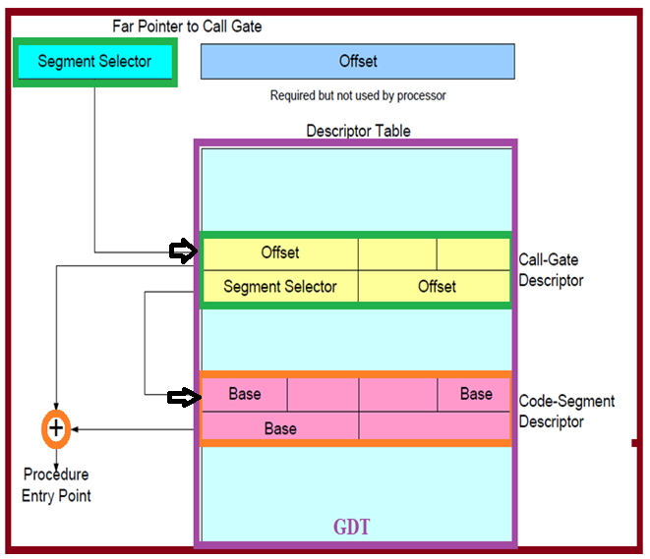
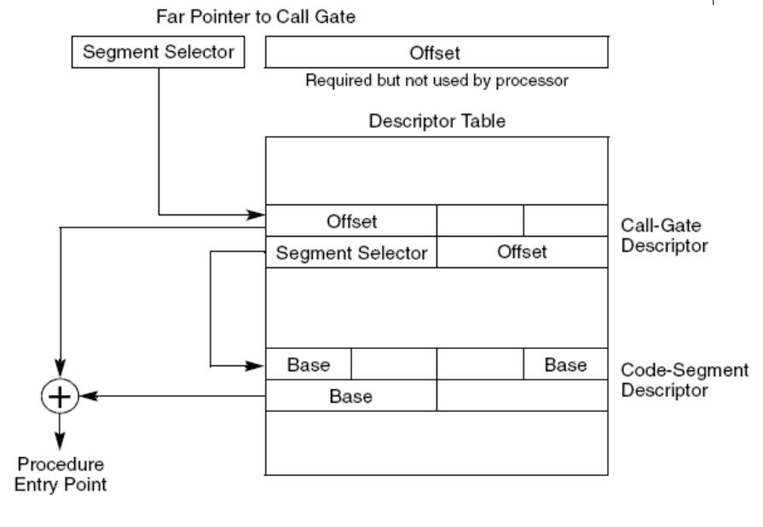
Accessing Non Conforming Code Segment using Call Gates

Slide 50
Code Segment ---(Accessing)--→ Non Conforming Code Segment [C=0] using Call Gates
Provides controlled transfers of program control between different privilege levels
It specifies the code segment to be accessed.
It defines an entry point for a procedure in the specified code segment.
It specifies the privilege level required for a caller trying to access the procedure.
If a stack switch occurs, it specifies the number of optional parameters to be copied between stacks.
It defines the size of values to be pushed onto the target stack: 16-bit gates force 16-bit pushes and 32-bit gates force 32-bit pushes.
It specifies whether the call-gate descriptor is valid.

Slide 51
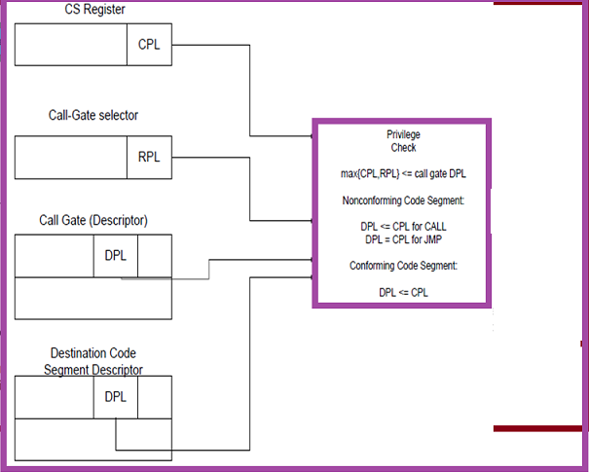
Privilege Check Rules for using Call Gates
CALL Gate- DPL indicates numerically highest privilege level that the currently executing program can be and still able to access the call gate.
Ex if DPL value in a call gate descriptor is 1 then only programs running at a CPL 0 or 1 can access the Call gate i.e. CPL <= DPL(Call gate)
Target DPL <= Max(RPL, CPL) <= Gate DPL
Only calls to the more privileged code segment are allowed.
Target DPL <= Max(RPL, CPL) <= Gate DPL

Slide 52
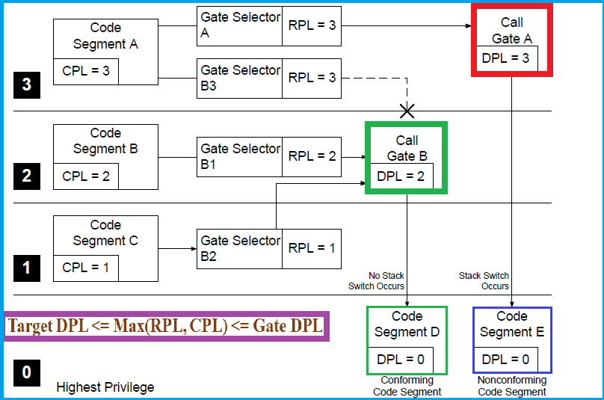
Privilege Check Rules for using Call Gates: Example

Slide 53
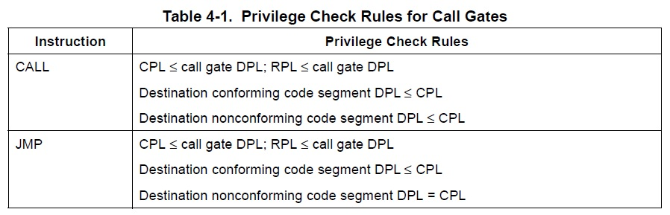
Rules

Slide 54
Stack Switching
Whenever a call gate is used to transfer program control to a more privileged nonconforming code segment (that is, when the DPL of the nonconforming destination code segment is less than the CPL), the processor automatically switches to the stack for the destination code segment’s privilege level.
This stack switching is carried out to prevent more privileged procedures from crashing due to insufficient stack space. It also prevents less privileged procedures from interfering (by accident or intent) with more privileged procedures through a shared stack.

Slide 55

Rules to access other code segment
CPL (calling program) | Non Conforming Code Segment CPL=DPL ( called program) | Conforming Code Segment CPL>=DPL ( called program) | Call Gate Descriptor (for called program) | Code Segment using Call Gate ( called program)
0 | 0 | 0 | 0,1,2,3 | 0
1 | 1 | 0,1 | 1,2,3 | 0,1
2 | 2 | 0,1,2 | 2,3 | 0,1,2
3 | 3 | 0,1,2,3 | 3 | 0,1,2,3

Slide 56
How to apply rules?
A program calls an external function ‘abc’
Replaced by logical address seg selector:
Offset 001B:0000H
0000 0000 0001 1011
Index = 3, TI=0, RPL=3
GDT is accessed with entry number 3

Slide 57
Possible segment descriptors at index 3
1. It is nonconforming segment with DPL=3; access allowed
2. It is conforming code segment with DPL=2; Access allowed but CPL=3 only; so no change in the accessible segments
3. It is a Call Gate Descriptor with DPL=3; the selector for code segment is accessed and DPL is checked if DPL of code segment = 2; access is allowed, CPL changes to 2 but care is taken that accessible segments are same as CPL=3

Slide 58
Privilege Checking
Prog. A cannot access Prog. X since no call gate available for A to access program at PL0
Prog. C can access Prog. X since call gate available for C to access program at PL0
A
B
Prog. B can access Prog. X since call gate available for B to access program at PL0
C
PL3
PL2
PL1
PL0
Gate for X
X
Gate for X

Slide 59
Privileged Instructions
Some instruction are protected from use by application program.
They can be executed with PL0
LGDT- load GDT Register
LLDT- Load LDT Register
LTR- load task register
LIDT- load IDT register
MOV (Control Registers) : MOV CRn, reg; MOV reg, CRn.
LMSW- load Machine Status Word (Lower 16 bits of CR0 register)
CLTS- clear task switch flag in CR0
WBINVD-invalidate cache with write back
INVLPG- invalidate TLB entry
HLT- halt Processor
RDMSR-read model specific register
WRMSR- write model specific register
RDPMC-read performance monitoring counter
RDTSC-read time stamp counter
MOV ( Debug registers) : MOV DRn, reg; MOV reg,DRn;
INVD- invalidate cache, without writeback

Slide 60
Paging

Slide 61
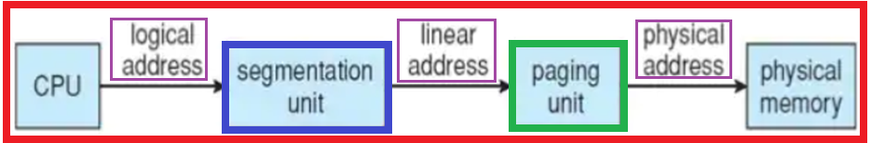
Page Translation
In the second phase of address transformation, the Pentium transforms a linear address into a physical address.
It is needed for page-oriented virtual-memory systems and page-level protection.
The page-translation step is optional.

Slide 62
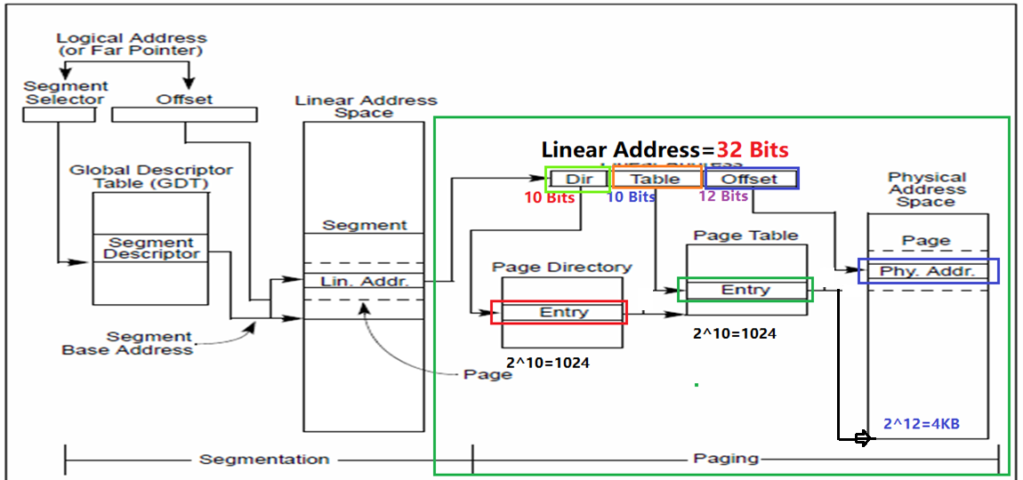
Segmentation and Paging
Upper 20 bits of CR3 become the Page Directory Base Register (PDBR), which stores the physical address of the first page directory entry.
PDBR
=20 BIT
PTE
PDE
1
4096

Slide 63
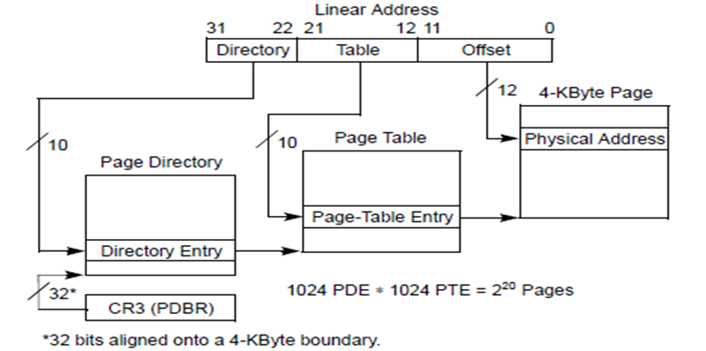
Linear Address Translation
PDBR:25000H ((Ignore lowest 12 bits)
Linear Address: 48E03005H
Page Directory Entry holding base address of page table 29000H
Page Table Entry Holding base address of page 12CD5 H
Calculate the Entry (entry out of 1024 entries) within page directory,
Entry within page table (entry out of 1024 entries)
Physical address

Slide 64
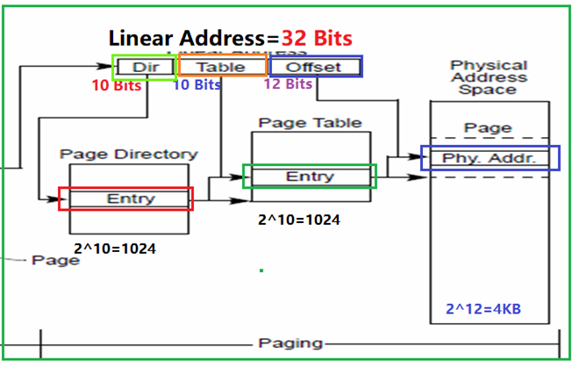
Paging
Upper 20 bits of CR3 become the page directory base register (PDBR), which stores the physical address of the first page directory entry.
PDBR=20 BIT
PTE
PDE
1
4096

Slide 65
Linear Address to Physical Address
Linear Address 32 Bits
Index to Directory (10 Bits) | Index to Table (10 Bits) | Offset in Page (12 Bits)
31 22 | 21 12 | 11 0
Page (Physical Add space)
4KB page
Page Directory
Page Table
Page Directory Entry
Page Table Entry
4KB page
4KB page
4KB page
Base address
CR3
PDBR

Slide 66
Example
PDBR:25000H ((Ignore lowest 12 bits)
Linear Address: 48E03005H
Find:
Entry No. in Page Directory (PDE)
Entry no. in Page Table (PTE)
Physical Address
Ans: ?
Page Directory Entry holding base address of page table 29000H
Page Table Entry Holding base address of page 12CD5 H
PDBR

Slide 67
Linear Address to Physical Address
base address of page table 29000H
base address of page 12CD5 H
Linear Address
PDBR:25000H
Linear Address: 48E03005H
0 | 1 | 0 | 0 | 1 | 0 | 0 | 0 | 1 | 1
1 | 0 | 0 | 0 | 0 | 0 | 0 | 0 | 1 | 1
005
Index to Directory | Index to Table | Offset in Page
123H | 203H | 005
123rd Hex (or 291st Directory Entry holding base address of page table 29000H
203rd in Hex or 515th Page Table Entry Holding base address of page 12CD5 H
4KB page
Base address
Page
Page
CR3
PDBR 25000H
Page Table Directory
Page Table

Slide 68
Example: Quiz Linear Address to Physical Address
Calculate the Entry (entry out of 1024 entries) within page directory,
Entry within page table (entry out of 1024 entries)
physical address,
if its PDBR is 12000H, Page Directory entry (Page Table Base Address) is 12345H,
Page Table entry (page frame base address) is 234D5 H
The linear address is 37F01004H.

Slide 69
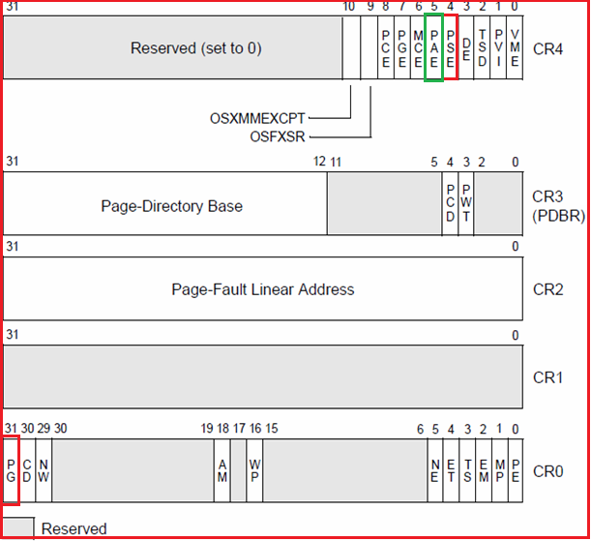
Control Registers
CR4:- Contains a group of flags that enable several architectural extensions
PSE (page size extensions)- 4-MByte pages or 2-MByte pages
PAE (physical address extension) flag bit 5 of CR4 Enables 36-bit physical addresses
CR3:- Contains the physical address of the base of the page directory. This register is also known as the page-directory base register (PDBR).
CR2 :- Contains the page-fault linear address (the linear address that caused a page fault)
CR1:- Reserved
CR0:- Contains system control flags that control operating mode and states of the processor.

Slide 70

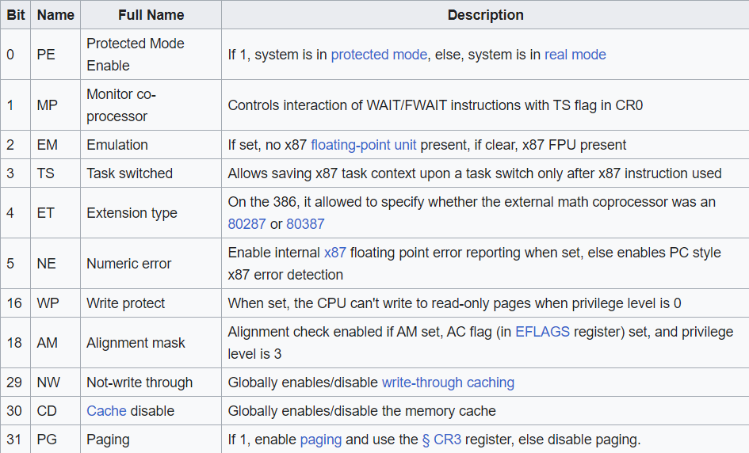
CR-0 Extra Information
CR0:- Contains system control flags that control operating mode and states of the processor.

Slide 71
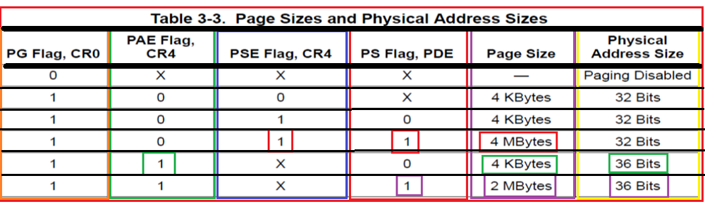
Components of the Paging Mechanism
3. Page: - 4-KByte, 2-Mbyte or 4-MByte
flat address space.
4. Page-Directory-Pointer Table
An array of four 64-bit entries, each of which points to a page directory. This data structure is only used when the physical address extension is enabled
PAE (Physical Address Extension) flag
PSE: (Physical Size Extension) flag
PS: Physical Size in PDE (Next slide)
PS: page Size in PDE Pg. No. 82 Volume 3

Slide 72
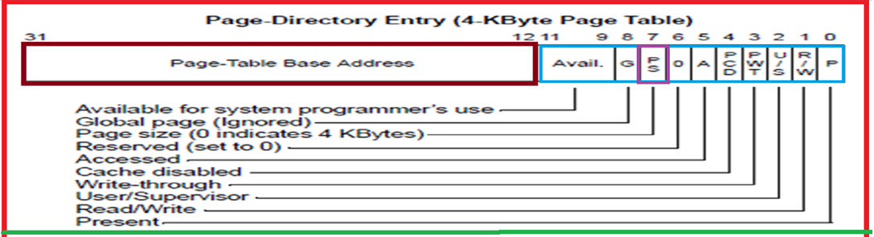

Slide 73
Paging Options
Paging is controlled by three flags in the processor’s control registers:
PG (paging) flag, bit 31 of CR0 : PE Bit 0 of CR0
Enables the page-translation mechanism. The operating system or executive usually sets this flag during processor initialization.
PSE (page size extensions) flag, bit 4 of CR4 : Enables large page size: 4-MByte pages or 2-MByte pages.
When the PSE flag is clear, the more common page length of 4 KBytes is used.
PAE (physical address extension) flag bit 5 of CR4: Enables 36-bit physical addresses
PS Flag in PDE: Page Size flag 0 means Page size=4KB and Page Size flag 1 means Page size=4MB

Slide 74
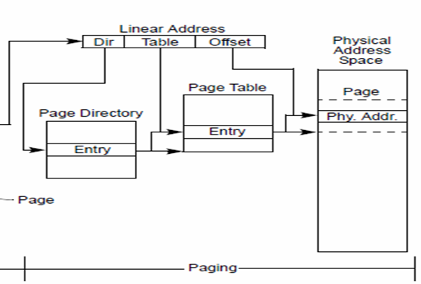
Components of the Paging Mechanism
1. Page Directory
An array of 32-bit page-directory entries (PDEs).
Up to 1024 page-directory entries can be held in a page directory.
Page Directory Entry points to Page Table
2. Page Table
An array of 32-bit page-table entries (PTEs.
Up to 1024 page-table entries can be held in a page table.
Page Table Entry points to Page Frame
3. Page: - A 4-KByte, 2-Mbyte or 4-MByte flat address space.
4. Page-Directory-Pointer Table
An array of four 64-bit entries, each of which points to a page directory. This data structure is only used when the physical address extension is enabled
(2^36=68 GB=68,71,94,76,736 Bytes)
PS: page Size in PDE Pg. No. 82 Volume 3

Slide 75
Continued..
One page directory can address 1M pages (2²⁰).
Because each page contains 4K bytes(2¹²) bytes, the tables of one page directory can span the entire physical address space (2²⁰ times 2¹² = 2³²).
The physical address of the current page directory is stored in the CPU register CR3, also called the page directory base register (PDBR).
Memory management software has the option of using one page directory for all tasks, one page directory for each task, or some combination of the two.

Slide 76
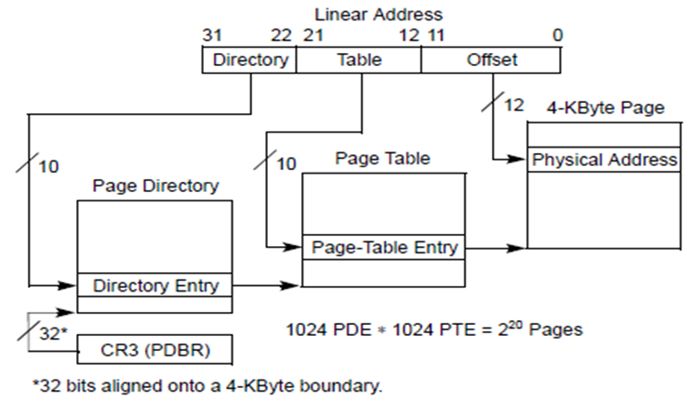
Linear Address Translation
To select the various table entries, the linear address is divided into three sections:
Page-Directory Entry (PDE)
Bits 22 through 31 provide an offset to an entry in the page directory.
The selected entry provides the base physical address of a page table.
Page-Table Entry (PTE)
Bits 12 through 21 of the linear address provide an offset to an entry in the selected page table.
This entry provides the base physical address of a page in physical memory.
Page offset
Bits 0 through 11 provides an offset to a physical address in the page.

Slide 77
PAGE DIRECTORY BASE REGISTER (PDBR)
The physical address of the current page directory is stored in the CR3 register (also called the page directory base register or PDBR).
CR2 is the Page Fault Linear Address register. It holds the 32-bit linear address which caused the last page fault detected.
If paging is to be used, the PDBR must be loaded as part of the processor initialization process (prior to enabling paging).
The PDBR can then be changed either explicitly by loading a new value in CR3 with a MOV instruction or implicitly as part of a task switch.

Slide 78
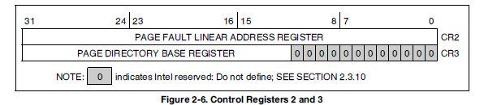
CR2,CR3
CR2: Holds the 32-bit linear address that caused the last page fault detected. It is used for handling page faults when PG is set.
CR3: Contains the physical base address of the page directory table. Since the page directory table is always 4 Kbyte-aligned, the lowest twelve bits of CR3 are ignored .

Slide 79

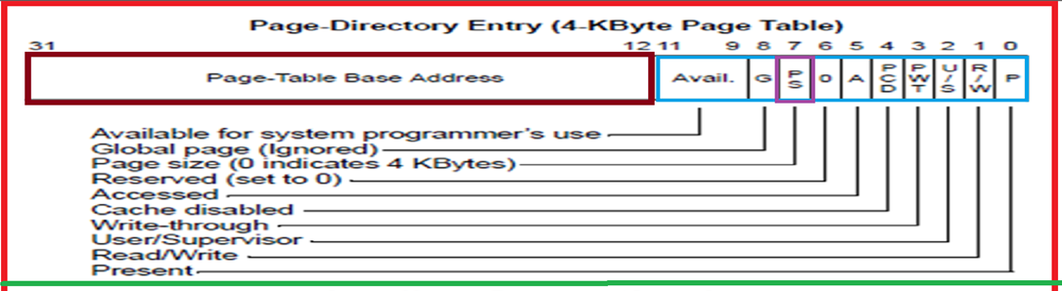
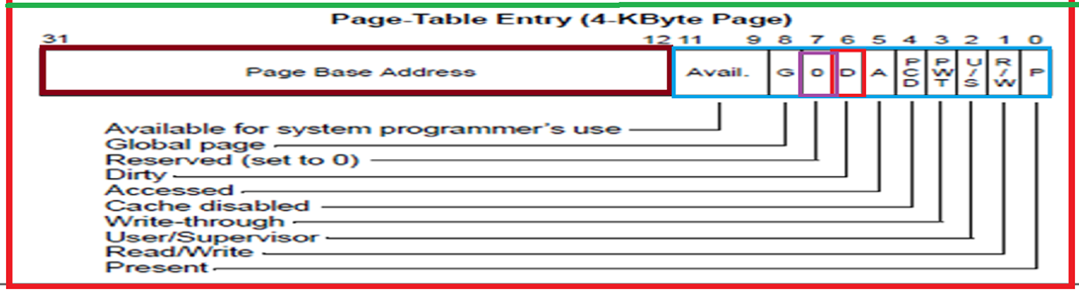
Page-Directory Entries (PDE) and Page-Table Entries (PTE)
Pg. No.88, Volume 3

Slide 80
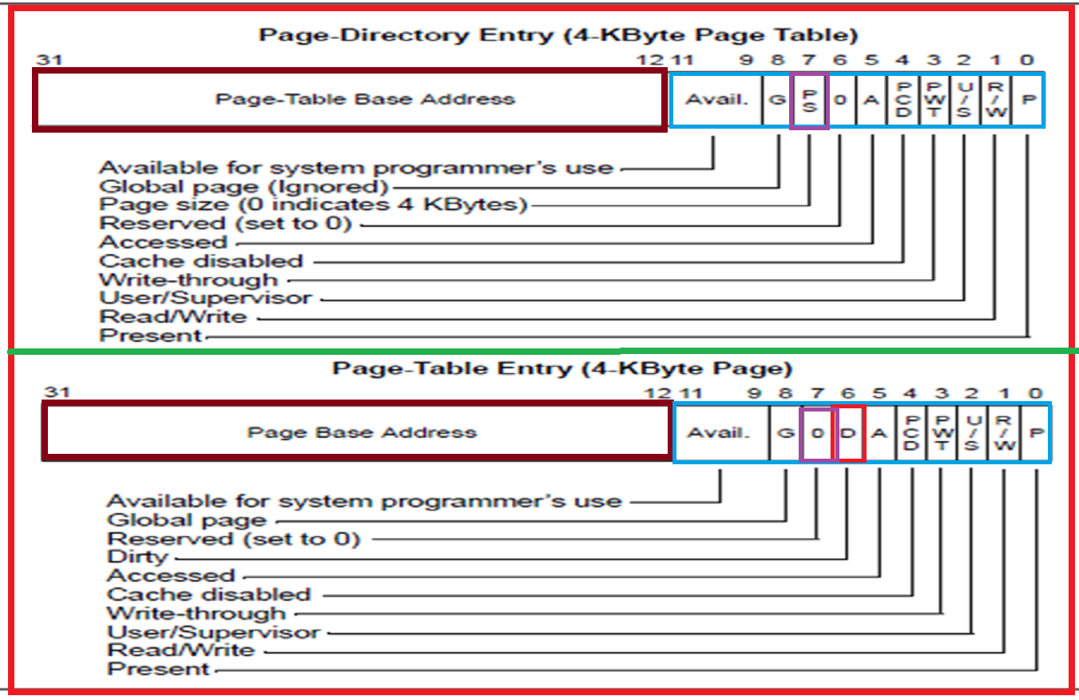
Page-Directory and Page-Table Entries
PWT: Page-level write-through
1: Write-Through caching is enabled for the associated page or page table;
0: Write-Back caching is enabled for the associated page or page table
PCD: Page-level cache disable
Controls the caching of individual pages or page tables.
1: caching of the associated page or page table is prevented;
0: the page or page table can be cached.
A :Accessed
Indicates whether a page or page table has been accessed or not
D: Dirty and accessed flags are provided for use by memory management software to
manage the transfer of pages and page tables into and out of physical memory.
It is Present only in PTE. When set, it indicates that the page has been written to. Only software can clear this flag.
Pg. No.88, Volume 3

Slide 81
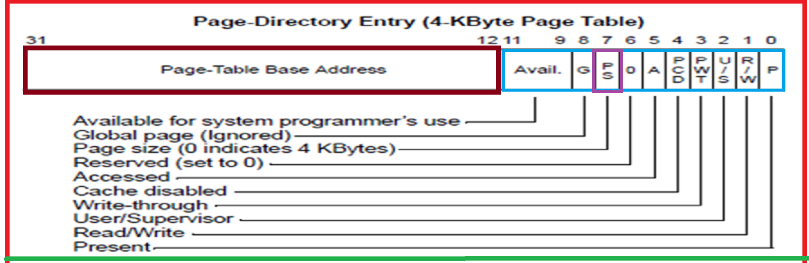
Page-Directory Entries (PDE)
(U/S) flag: When this flag is clear, the page is assigned the supervisor privilege level;
when the flag is set, the page is assigned the user privilege level.
PS=0 means-Page size is 4KB and 1 means Page size=4MB

Slide 82
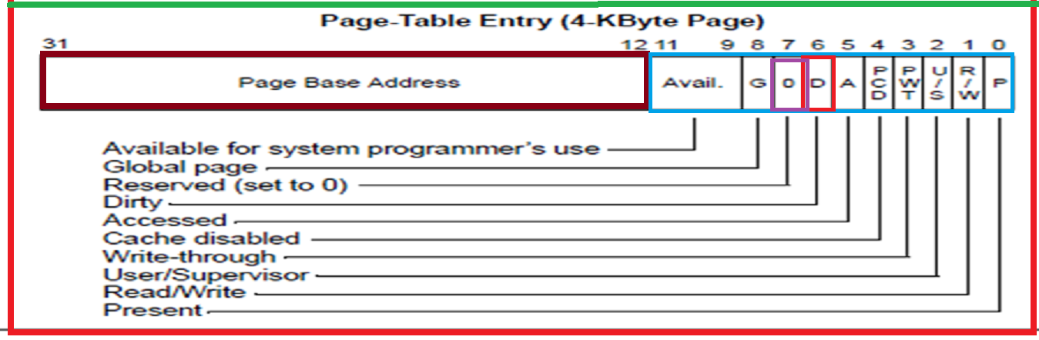
Page-Table Entries (PTE)

Slide 83
Page-Directory Entries and Page Table Entries
Page base address: Specifies the 20 most significant bits of the physical address of the first byte of a 4-KByte Page Table or Page.
Present (P): When P bit is set, it Indicates that the page table or page being pointed to by the entry is currently loaded in the physical memory and can be used. When the flag is clear, and if the processor attempts to access the table or the page, then a page-fault exception is generated (#PF).
Making P bit in PDE zero, makes all the 1024 pages described in that table inaccessible.
Read/write (R/W) flag: Specifies the read-write privileges for a group of pages described in the page table or individual page.
When this flag is clear, the page is read only and
when the flag is set, the page can be read and written into.

Slide 84
Page-Directory Entries and Page Table Entries
User/supervisor (U/S) flag: Specifies the user-supervisor privileges for a page or group of pages.
When this flag is clear, the page is assigned the supervisor privilege level;
when the flag is set, the page is assigned the user privilege level.
Page-level write-through (PWT) flag:
When the PWT flag is set, write-through caching is enabled for the associated page or page table;
when the flag is clear, write-back caching is enabled for the associated page or page table
Page-level cache disable (PCD) flag:
When the PCD flag is set, caching of the associated page or page table is prevented and
when the flag is clear, the page or page table can be cached.
Accessed (A) flag: Indicates whether a page or page table has been accessed (read from or written to) when set.
Once set, the processor does not implicitly clear it. Only software can clear this flag.

Slide 85
Page-Directory Entries and Page Table Entries
Dirty (D) flag: It is Present only in PTE. When set, it indicates that the page has been written to. Only software can clear this flag.
Page size (PS) flag: It is Present only in PDE. When this flag is clear, the page size is 4 KB. When the flag is set, the page size is 4 MB for normal 32-bit addressing.
Global (G) flag: When set, it indicates a global page and is not flushed from TLB at the time of task switching ( Provided page global enable (PGE) flag in register CR4 is set)
Reserved and available-to-software bits: Bits marked as 0 are reserved and cannot be used. Bits marked as Avl are available for system program for using as flags.

Slide 86
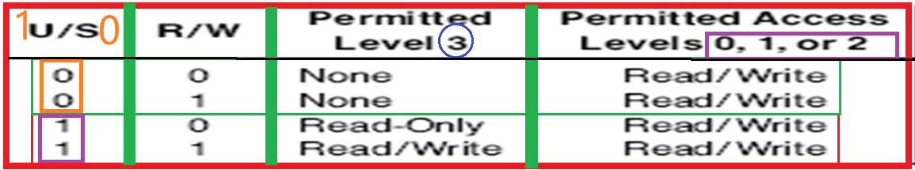
Page Level Protection
The paging mechanism distinguishes between two levels of protection:
User which corresponds to level 3 of the segmentation based protection
supervisor which encompasses all of the other privilege levels (0, 1, 2).
Programs executing at Level 0, 1 or 2 bypass the page protection, although segmentation based protection is still enforced by the hardware.
The U/S and R/W bits are used to provide User/Supervisor and Read/Write protection for individual pages or for all the pages in a table

Slide 87
Syllabus--- Module IV: Paging and Protection
Protection by segmentation:
Privilege-levels
Rules of inter-privilege level transfer for Data and Code segments
Page level protection.
Paging Unit:
support registers
related data structures
linear to physical address translation
TLB

Slide 88

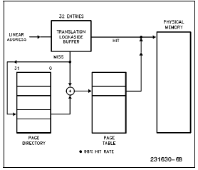
Translation Lookaside Buffer (TLB)
The processor stores the most recently used page-directory and page-table entries in on-chip caches called translation lookaside buffers or TLBs.

Slide 89
Translation Look aside Buffer(TLB)
The processor stores the most recently used page-directory and page-table entries in on-chip caches called translation lookaside buffers or TLBs.
To minimize the number of bus cycles required for address translation, the most recently accessed page-directory entries and page-table entries are cached in the processor in devices called translation look aside buffers (TLBs).
It is a four-way set associative, 32-entry page table instruction cache and 64-entry page table data cache.
Most paging is performed using the contents of the TLBs.
The TLBs are inaccessible to application programs and tasks (privilege level greater than 0); that is, they cannot invalidate (flush) TLBs.
Only operating system or executive procedures running at privilege level of 0 can invalidate (flush) TLBs or selected TLB entries.
The INVLPG- privileged instruction (invalidate TLB entry) instruction is provided to invalidate (flush) a specific page-table entry in the TLB. (Whenever a page-directory or page-table entry is changed, the operating-system must immediately invalidate the corresponding entry in the TLB, so that it can be updated the next time the entry is referenced).

Slide 90
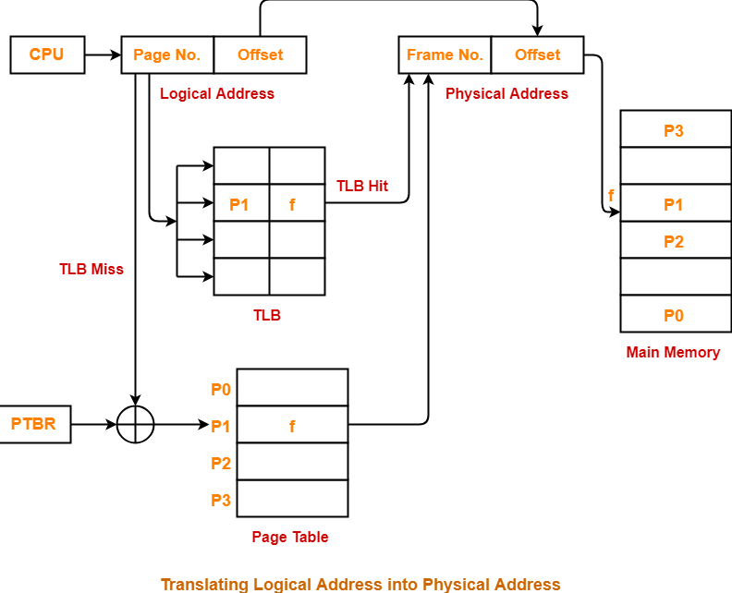
Translation Look aside Buffer (TLB)
The paging unit hardware receives a 32-bit linear address from the segmentation unit.
The upper 20 linear address bits are compared with all 32 entries in the TLB to determine if there is a match or not.
TLB Hit: then the 32-bit physical address is calculated and will be placed on the address bus.
TLB Miss: then the address calculation is done by finding appropriate Page directory and Page table

Slide 91
TLB Hit and TLB Miss
The paging unit hardware receives a 32-bit linear address from the segmentation unit.
The upper 20 linear address bits are compared with all 32 entries in the TLB to determine if there is a match or not.
If there is a match (i.e. a TLB Hit), then the 32-bit physical address is calculated and will be placed on the address bus.
If P =1 on the Page Directory Entry indicating that the page table is in memory, then the Pentium will read the appropriate Page Table Entry.
If there is No match (i.e. a TLB Miss), then the address calculation is done by finding appropriate Page directory and Page table.

Slide 92
Who is responsible?
The operating system is responsible for setting up the initial page tables, and handling any page faults.
The operating system also is required to invalidate (i.e. flush) the TLB, when any changes are made to any of the page table entries.
It is done by loading CR3 with the address of the Page Directory, and allocating space for the Page Directory and the Page Tables.

Slide 93


